Slide 1
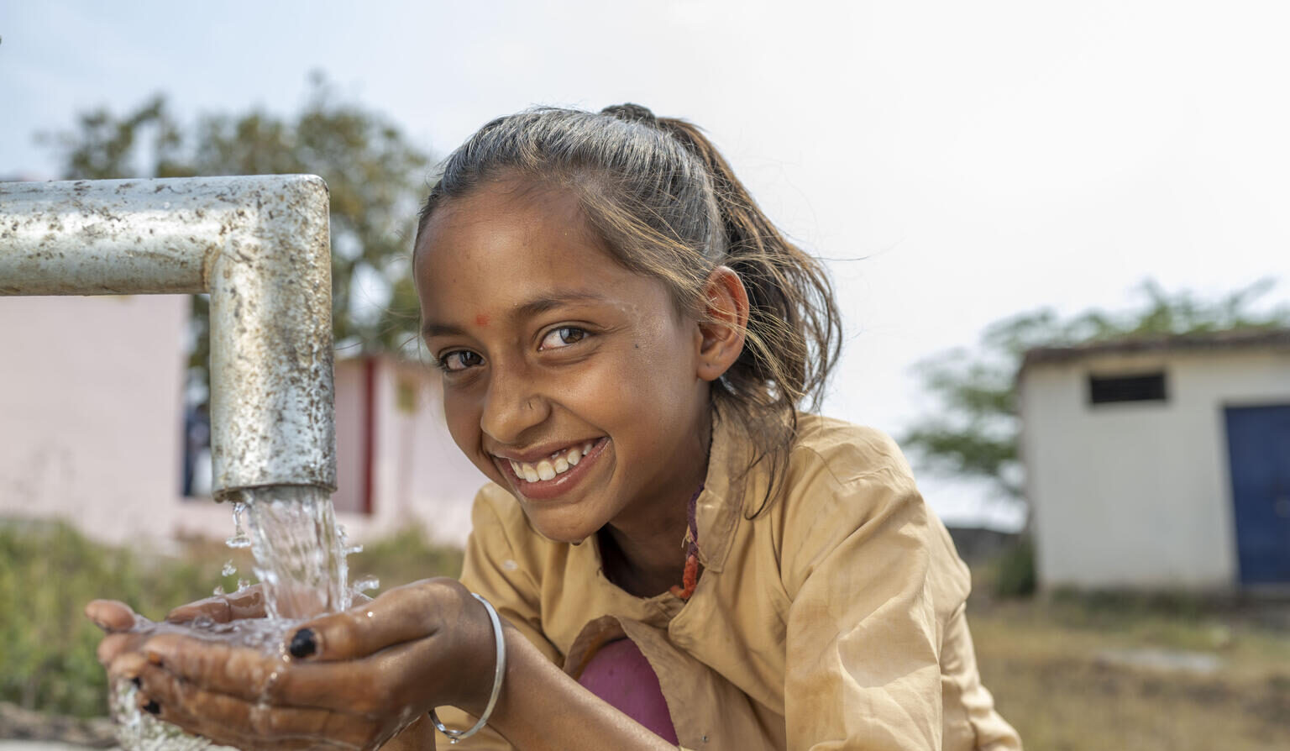
Updated regional estimates for WASH in schools: are countries on track for SDG targets?
WHO/UNICEF Joint Monitoring Programme (JMP)
washdata.org
9th International Learning Exchange
31 August 2022
7th WASH in Schools ILE, Manila 11 November 2019

Slide 2
Outline
What proportion of schools had basic WASH services in 2021?
Are countries on track to meet the SDGs for WinS by 2030?
What countries are monitoring beyond basic service, including pandemic preparedness and disability-inclusive WASH?
How can monitoring be improved to support meeting the SDGs and ensuring schools have basic and inclusive WASH services?

Slide 3
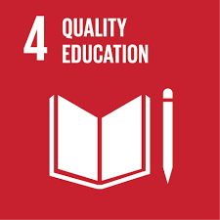
4.a Build and upgrade education facilities that are child, disability and gender sensitive and provide safe, nonviolent, inclusive and effective learning environments for all
4.a.1 Proportion of schools with: …(e) basic drinking water; (f) single-sex basic sanitation facilities; and (g) basic handwashing facilities (as per WASH indicator definitions)
Notes:
SDG4 has a target on effective learning environments which includes basic drinking water, sanitation and hygiene in schools
This target calls for close collaboration between WASH and Education sectors

Slide 4
4.a Build and upgrade education facilities that are child, disability and gender sensitive and provide safe, nonviolent, inclusive and effective learning environments for all
4.a.1 Proportion of schools with: …(e) basic drinking water; (f) single-sex basic sanitation facilities; and (g) basic handwashing facilities (as per WASH indicator definitions)
Notes:
The JMP ladders focus on progress towards a basic level of drinking water, sanitation and hygiene service in schools which is the indicator used for SDG monitoring
Agreed upon by Expert Group representing multiple regions and organizations, including UNESCO-UIS.

Slide 5
National data sources used in the JMP 2022 report
The JMP produces updated estimates on WASH in schools every 2 years
A total of 1,029 national data sources were used in the 2022 update
Many data are from EMIS
Notes:
A total of 1,029 national data sources were used for the 2022 update report
Average of 5.6 datasets per country (182 countries)
Data sources include EMIS, periodic censuses, UNESCO Institute for Statistics data, and surveys
Data were mapped to the indicator elements to standardize results between surveys and countries to the extent possible

Slide 6
How are WASH in schools data collected in your country? EMIS (annual census of all schools) Survey (not all schools, not annual) Other I don’t know
POLL
Notes:
To add to zoom platform

Slide 7
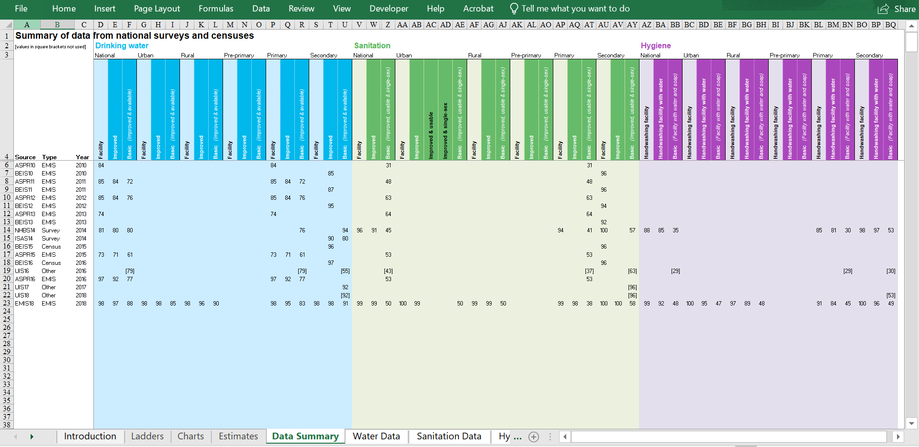
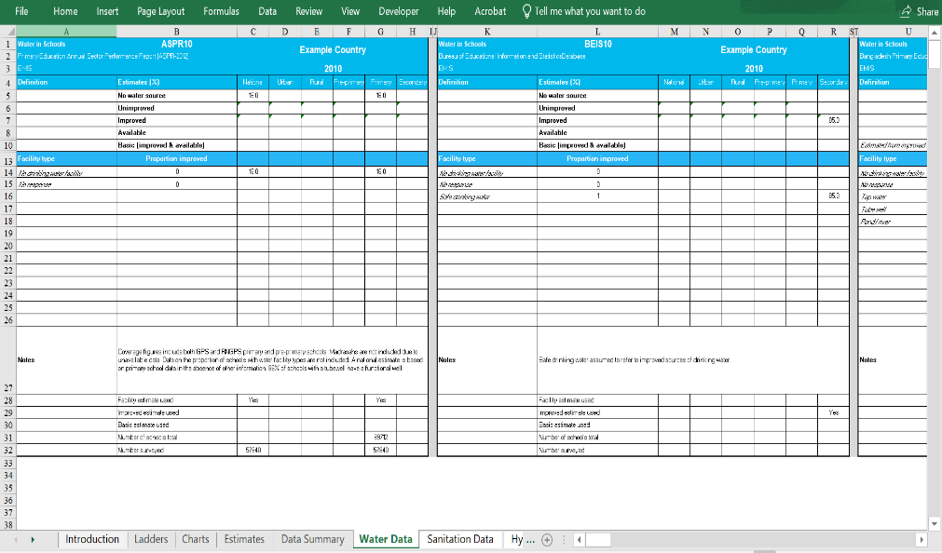
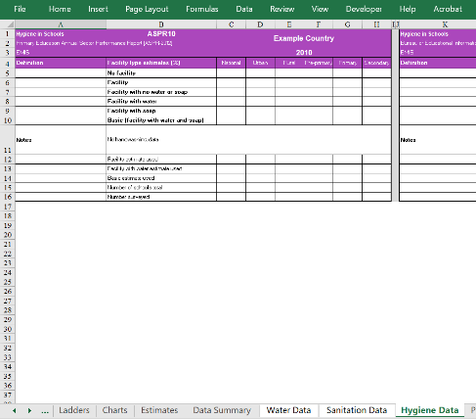
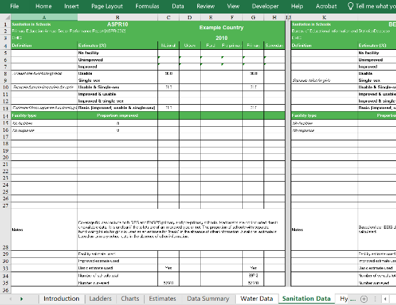
JMP Country Consultation on WinS
National data sources are compiled in a “JMP Country File”
Country consultation is facilitated by UNICEF country offices and aims to engage relevant national stakeholders to review the Country File
Focuses on 3 main questions:
Is the country file missing any relevant national sources of data on WASH in schools?
Are the data sources listed considered reliable and suitable?
Is the JMP interpretation and classification accurate and appropriate?
For the purpose of global monitoring and comparison the JMP seeks to apply the same rules to all countries. JMP estimates may therefore differ from national data.
Notes:
National data sources are compiled in “JMP Country Files” and estimates are calculated using JMP rules.
A JMP country consultation is then facilitated by UNICEF country offices which aims to engage National Statistics Offices and other relevant stakeholders to review the draft estimates in the “JMP Country File”
The consultation focuses on 3 main questions:
Since the JMP tries to apply the same rules to all countries to support cross-country comparison and global reporting, the JMP estimates may differ from national figures.

Slide 8
Which countries had data for the baseline JMP report in 2018? (as presented at the 6th WinS ILE in Myanmar in 2017)
Country | Basic Water | Basic Sanitation | Basic Hygiene
Afghanistan
Bangladesh
Bhutan
Cambodia
China
Cook Islands
DPR Korea
Fiji
India
Indonesia
Kiribati
Lao PDR
Malaysia
Maldives
Marshall Islands
Micronesia
Mongolia
Myanmar
Country | Basic Water | Basic Sanitation | Basic Hygiene
Nauru
Nepal
Niue
Pakistan
Palau
Papua New Guinea
Philippines
Samoa
Solomon Islands
Sri Lanka
Thailand
Timor-Leste
Tokelau
Tonga
Tuvalu
Vanuatu
Viet Nam
Notes:
For the baseline report in 2018, a few countries in the Asia-Pacific regions already had data with 4 countries able to report on all three elements of basic services (water, sanitation, and hygiene).

Slide 9
Which countries had data for the 2022 JMP report?
Country | Basic Water | Basic Sanitation | Basic Hygiene
Afghanistan
Bangladesh
Bhutan
Cambodia
China
Cook Islands
DPR Korea
Fiji
India
Indonesia
Kiribati
Lao PDR
Malaysia
Maldives
Marshall Islands
Micronesia
Mongolia
Myanmar
Country | Basic Water | Basic Sanitation | Basic Hygiene
Nauru
Nepal
Niue
Pakistan
Palau
Papua New Guinea
Philippines
Samoa
Solomon Islands
Sri Lanka
Thailand
Timor-Leste
Tokelau
Tonga
Tuvalu
Vanuatu
Viet Nam
Notes:
A significant amount of data for the 2022 report came from the SA and EAP regions with 17 countries able to report on all three elements of basic services.
What a huge improvement in data availability in the past 5 years!

Slide 10
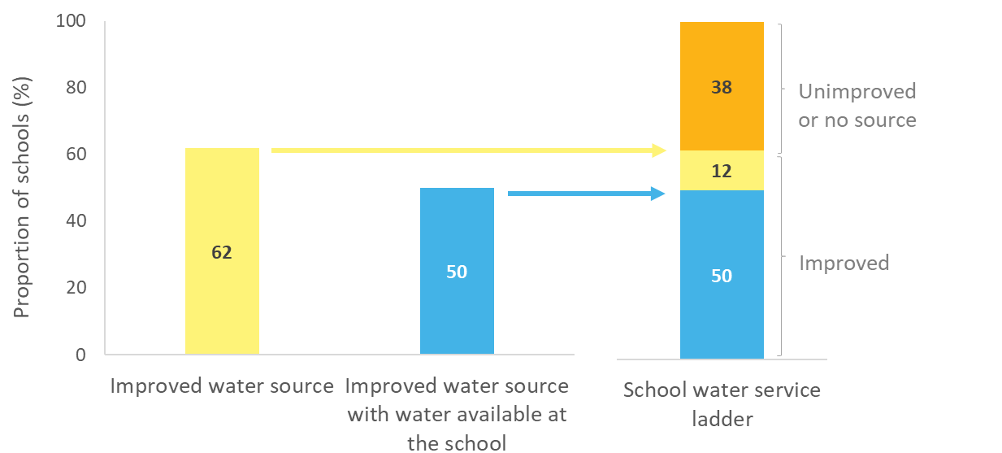
Example: Constructing a drinking water service ladder

Slide 11
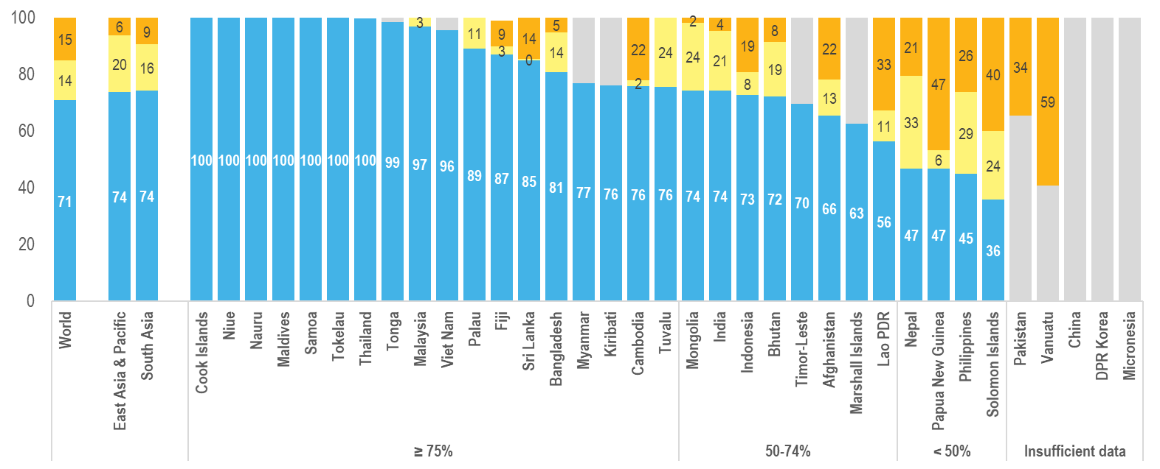
Basic drinking water in schools (2021)
Estimates for 30 countries in the EAP and SA regions (up from 22)
Notes:
30 countries in EAP and SA had sufficient data to estimate coverage of basic services in 2021 (up from 22 in the previous update). <50% of schools in four of the 30 countries. 8 are below the global average.

Slide 12
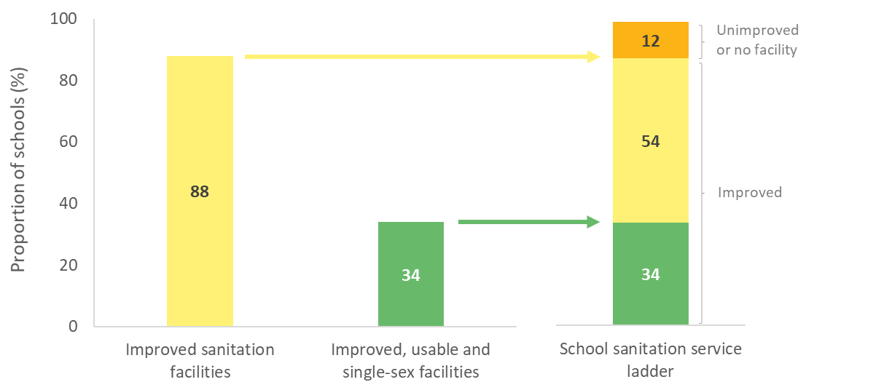
Example: Constructing a sanitation service ladder

Slide 13
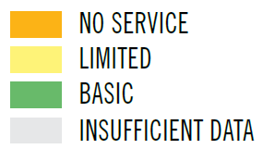
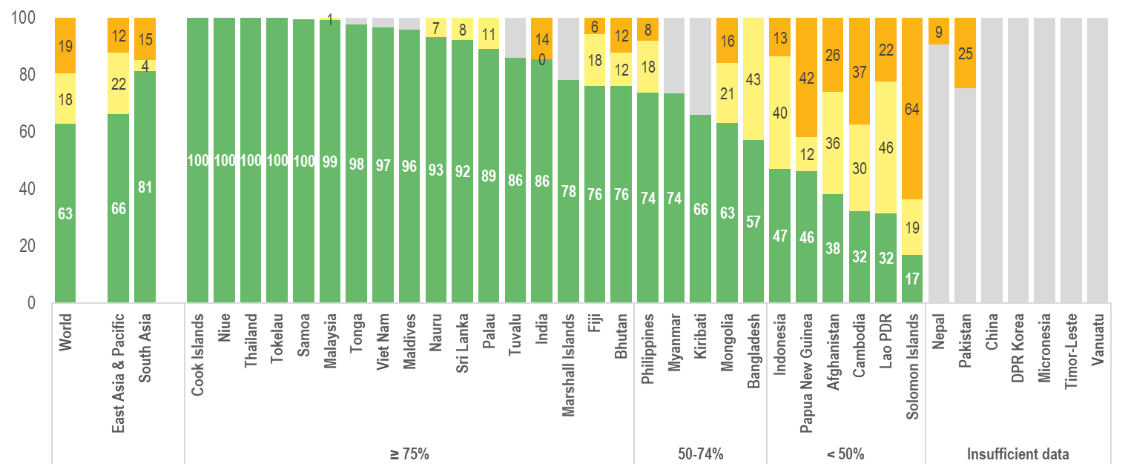
Basic sanitation in schools (2021)
Estimates for 28 countries in the EAP and SA regions (up from 21), 6 of which are <50%
7 countries had insufficient data to estimate basic service
Notes:
28 countries in EAP and SA had sufficient data to estimate coverage of basic services in 2021 (up from 21 in 2019). Coverage is less than 50% in 6 of the 28. 7 are below the global average.

Slide 14
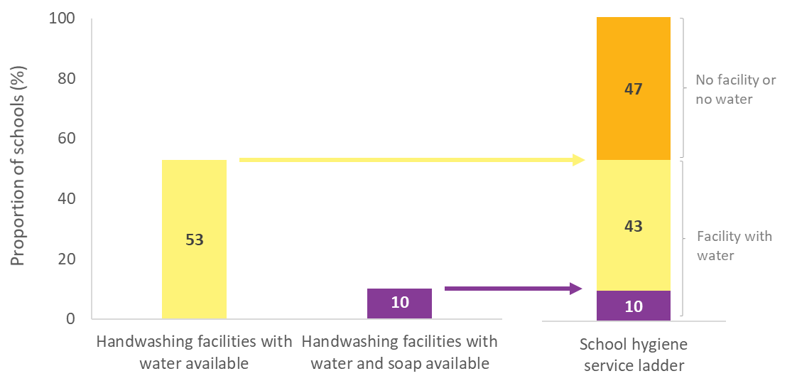
Example: Constructing a hygiene service ladder

Slide 15
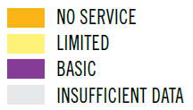
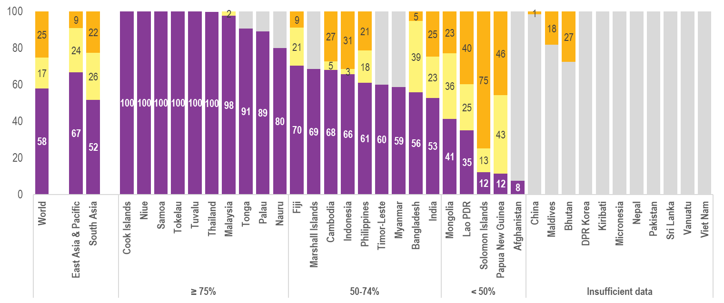
Basic hygiene in schools (2021)
Estimates for 24 countries in the EAP and SA regions (up from 18), of which 5 are <50%
11 countries had insufficient data to estimate basic service
Notes:
24 countries in EAP and SA had sufficient data to estimate coverage of basic hygiene services in 2021 (up from 18 for 2019). 5 of which are <50% and 7 are below the global average.

Slide 16
Of the countries that don’t already have >99% coverage, how many do you think are on track to meet the SDGs? All countries Most countries A few countries No countries
POLL
Notes:
To add to zoom platform

Slide 17
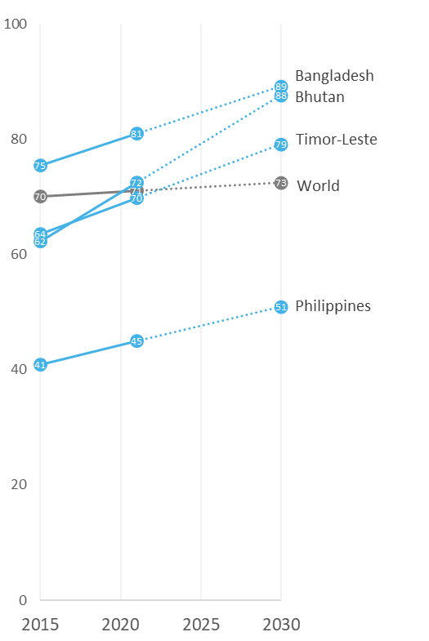
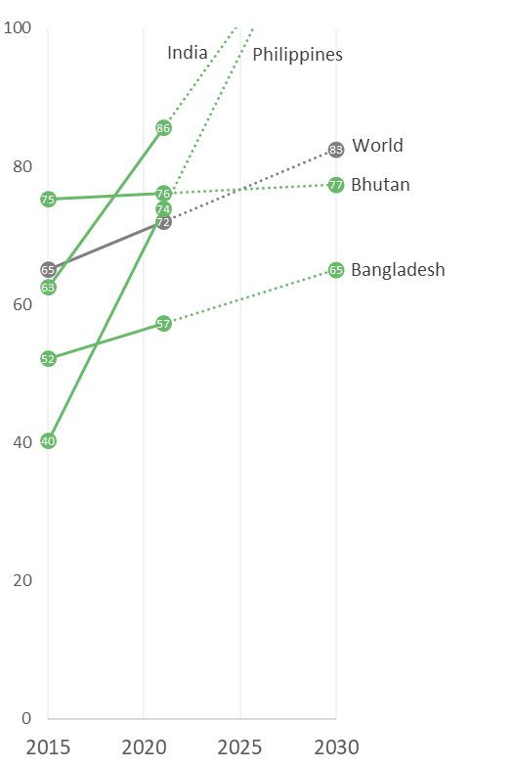
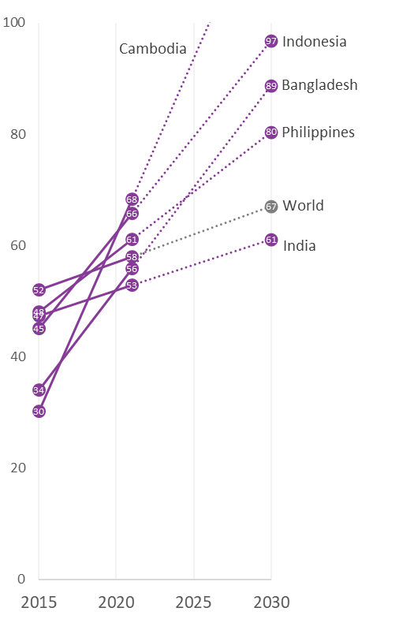
Trends in basic drinking water, sanitation, and hygiene in schools (%), 2015-2021
Trend data are available for few countries. Meeting the SDGs will require accelerating current rates of progress, but progress for countries in SA and EAP is often faster than the global average.
Hygiene coverage is rapidly improving in many countries. Cambodia is on track to meet the SDG target for basic hygiene.
India and the Philippines are on track to meet the SDG target for basic sanitation in schools.
Notes:
While some progress on WASH in schools has been made since the start of the SDGs it is much too slow to meet the SDGs by 2030.
However rates of progress tend to be faster in SA and EAP compared to global averages. (ILE impact?)
Trend data are only available for few countries in the SA and EAP regions.
Of those, India and the Philippines are on track to meet the SDG for sanitation in schools and Cambodia is on track to meet the SDG for hygiene in schools, but progress for other elements and countries with data is too slow.

Slide 18
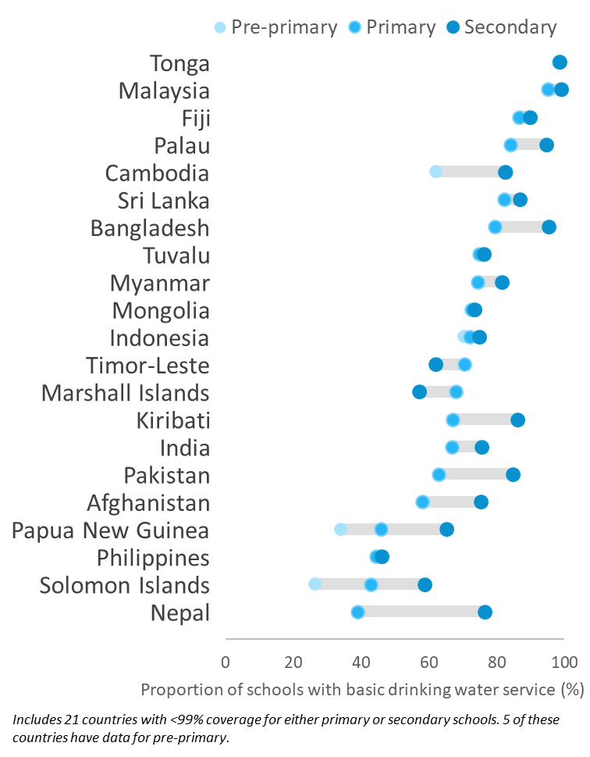
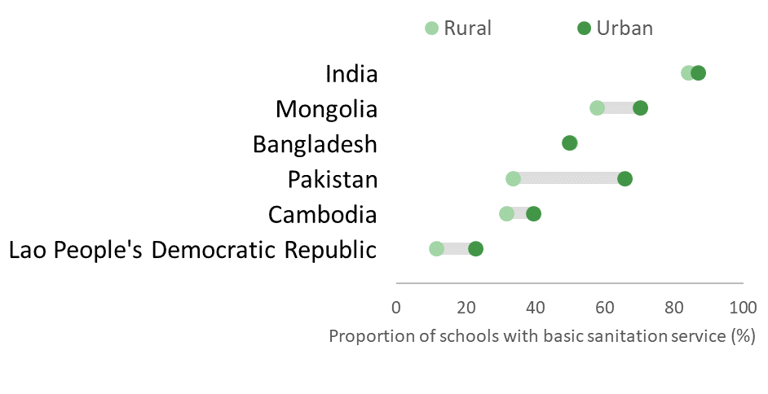
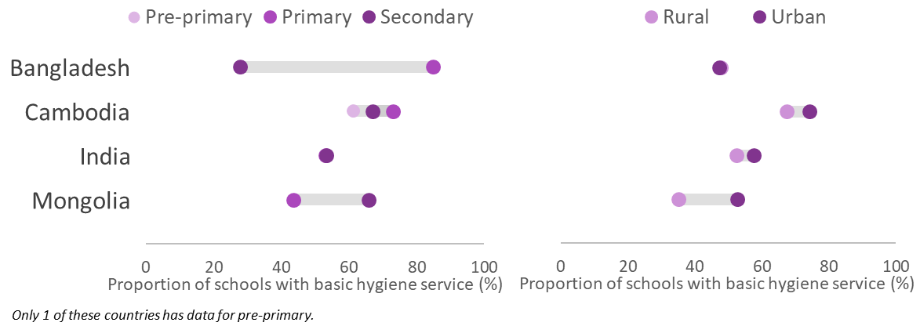
Disaggregated data reveal disparities between urban and rural and school levels
Notes:
Some countries have data disaggregated by urban and rural, and by school level.
For some countries difference is small, for some big difference, such as Mongolia for hygiene in different school levels, but not for water, whereas in India there is a fairly consistent gap for all indicators and settings.
Typically, primary schools have lower coverage than secondary schools but this is not always the case. For example, in Bangladesh, primary schools have much higher coverage for hygiene than secondary schools.
Where we do have data on pre-primary it’s often even lower than primary schools

Slide 19
JMP service ladders for WASH in schools
Drinking Water |  | Sanitation |  | Hygiene
Advance service: Additional criteria may include quality, quantity, continuity, and accessibility to all users |  | Advanced service: Additional criteria may include student per toilet ratios, menstrual hygiene facilities, cleanliness, accessibility to all users, and excreta management systems |  | Advanced service: Additional criteria may include hygiene education, group handwashing, menstrual hygiene materials, and accessibility to all users
Basic service: Drinking water from an improved source and water is available at the school at the time of the survey |  | Basic service: Improved sanitation facilities at the school that are single-sex and usable (available, functional and private) at the time of the survey |  | Basic service: Handwashing facilities with water and soap available at the school at the time of the survey
Limited service: Drinking water from an improved source but water is unavailable at the school at the time of the survey |  | Limited service: Improved sanitation facilities at the school that are either not single-sex or not usable at the time of the survey |  | Limited service: Handwashing facilities with water but no soap available at the school at the time of the survey
No service: Drinking water from an unimproved source or no water source at the school |  | No service: Unimproved sanitation facilities or no sanitation facilities at the school |  | No service: No handwashing facilities available or no water available at the school
Notes:
It is recognised that this basic minimum level of service is not sufficient for full realization of the human rights to education, safe water and sanitation and that additional rungs may be needed in future to monitor advanced service levels.
We try to focus on a specific area each report. MHH was a focus last report and has been focus of the ILE. More on this in upcoming side sessions.
The JMP latest global report on WASH in schools includes two pull-out sections with examples of monitoring beyond basic service, including pandemic preparedness and disability-inclusive WASH in schools.

Slide 20
All three elements of WASH are critical for pandemic preparedness, but few schools met the criteria for all three basic WASH services
Notes:
All three elements of WASH are critical to prevent the spread of COVID-19 and support a safe learning environment.
We see a sharp decrease in coverage for many countries when we consider the proportion of schools with access to all three elements of WASH.

Slide 21
Examples of monitoring pandemic preparedness
In Cambodia, availability of group handwashing facilities has increased in all levels and areas
In the Philippines, availability of handwashing facilities in toilets and canteens has increased rapidly primary schools
In Afghanistan and Lao PDR, data highlight the challenge of toilet cleanliness
Notes:
In the few countries that monitor pandemic preparedness beyond basic WASH services, many schools do not have important elements of infection prevention and control (IPC) such as environmental cleaning materials, safe solid waste management, or hygiene promotion with easily accessible facilities for handwashing before eating and after using the toilet.
However, there are positive examples as well. For example, …

Slide 22
Examples of monitoring disability inclusive WASH
Far fewer schools have WASH facilities that are disability accessible
Coverage of disability-accessible toilets often varies by school level
Coverage of disability-accessible toilets depends on the criteria used for classification
Notes:
And, the provision of disability-accessible infrastructure in schools goes far beyond WASH services

Slide 23
What other indicators (beyond basic service) do you think should be monitored? [Please enter your response in the chatbox]
POLL

Slide 24
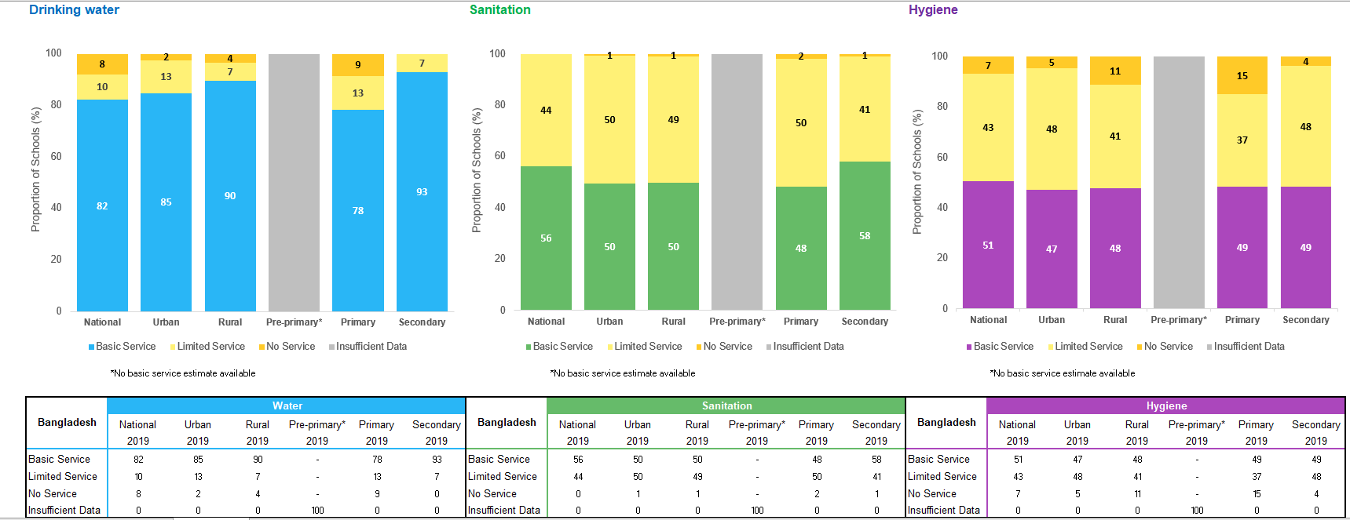
See the data used for national estimates here: washdata.org/data/downloads (now in multiple languages!)
Notes:
Country files are available online for 182 countries including detailed data and sources that were used and assumptions made
Detailed data files are available on washdata.org.

Slide 25
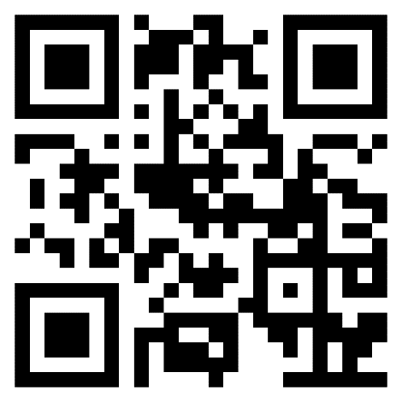
Wrap up
Some countries are on track to meet the SDGs for sanitation or hygiene in schools!
Meeting the SDGs for WinS will require accelerating current rates of progress for most countries
What next?
Join the JMP side session to share experiences and improve monitoring of basic (& inclusive!) WinS.
Join the Global MHH Monitoring Group side session to learn about monitoring MHH in more detail.
Register for the JMP side session here:
Notes:
The JMP side session will be workshop style and take place over two days (1-2 hours each day). Link for QR code: https://forms.gle/GftsprAhhZR8Xfa87.
…and for a more in-depth dive into monitoring MHH, check out the Global MHH Monitoring Group session on the new recommended indicators for MHH!

Slide 26
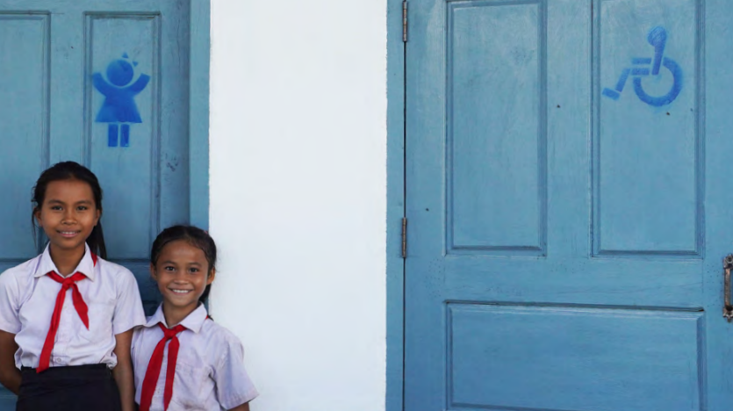
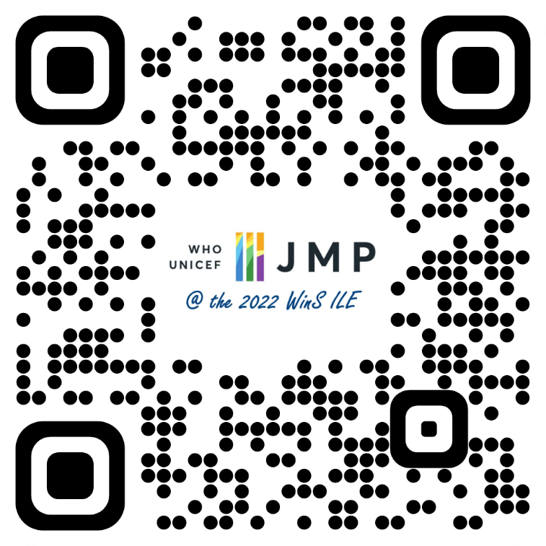
Thank you!
info@washdata.org
Slides and resources can be downloaded here:

